Slide 1
Probabilistic language modeling:
An introduction to the Rational Speech Act framework
Dasha Popova
07.03.2024

Slide 2
Grice, 1975 “Logic and Conversation”
“what is said” vs. “what is implicated”
A: How is C getting on in his job?
B: Oh quite well, I think; he likes his colleagues, and he hasn’t been to prison yet
CONVERSATIONAL IMPLICATURES

Slide 3
Grice, 1975 “Logic and Conversation”
Cooperative Principle
Make your conversational contribution such as is required, at the stage at which it occurs, by the accepted purpose or direction of the talk exchange in which you are engaged.
Can you think of the situations where the principle is violated?

Slide 4
Grice, 1975 “Logic and Conversation”
Maxims of Quality
Try to make your contribution one that is true.
a. Do not say what you believe to be false.
b. Do not say that for which you lack adequate evidence.

Slide 5
Grice, 1975 “Logic and Conversation”
Maxims of Quantity
a. Make your contribution as informative as is required (for the current purposes of the exchange).
b. Do not make your contribution more informative than is required.
A: Where are you from?
B: From Germany / From Berlin / From Potsdam.

Slide 6
Grice, 1975 “Logic and Conversation”
Maxim of Relation (Relevance)
Be relevant
A: Where’s Bill?
B: There’s a yellow VW outside Sally’s house. (Levinson, 1983)

Slide 7
Grice, 1975 “Logic and Conversation”
Maxims of Manner
Be perspicuous:
a. Avoid obscurity of expression.
b. Avoid ambiguity.
c. Be brief (avoid unnecessary prolixity).
d. Be orderly.

Slide 8
Grice, 1975 “Logic and Conversation”
These are general principles of rational cooperative behavior not specific to the language use
Can you think of some examples outside of the linguistic domain?

Slide 9
Grice, 1975 “Logic and Conversation”
Alan: Are you going to Paul’s party?
Barb: I have to work.
Barb meant that she is not going to Paul’s party by saying that she has to work. She did not say that she is not going to Paul’s party, and the sentence she uttered does not mean that. Grice introduced the technical terms implicate and implicature for the case in which what the speaker said is distinct from what the speaker thereby meant or implied. Thus Barb implicated that she is not going; that she is not going was her implicature.

Slide 10
Horn, 1972 Scalar implicatures
A scalar implicature is a quantity implicature based on the use of an informationally weak term in an implicational scale.
Scale: SOME (less informative: some, all) -- ALL (more informative: all)
The pianist played some Mozart sonatas
More informative alternative utterance: The pianist played all Mozart sonatas
Scalar implicature: The pianist did not play all Mozart sonatas
The choice by the speaker of a less informative utterance implies the negation of the more informative alternative (some = not all).

Slide 11
Scalar implicatures
An implicational scale is a set of lexical items that are
of the same constituent category, and
ordered in terms of their informativeness.
Any sentence including one item of the set entails all of the propositions expressed by similar sentences containing less informative items. In addition, in keeping with the quantity maxim, the use of an item in the scale creates scalar implicatures that disallow the propositions expressed by similar sentences that contain more informative items.
Examples: (English)
{all, most, many, some}
{always, often, sometimes}
{succeed in, try to, want to}
{certain, probable, possible}
Can you think of more examples for English? Can you think of examples for other languages? Do you predict the scales to be universal or language-specific? What is your hunch?

Slide 12
The Rational Speech Act framework
pragmatics: speakers and listeners reason about each other’s reasoning about the literal interpretation of utterances
modeling
probabilistic approach
general theory of communication that can be used for modeling complex phenomena, like metaphor (Kao et al., 2014), hyperbole (Kao et al., 2014), degree semantics (Lassiter and Goodman, 2013)

Slide 13
The Rational Speech Act framework
communication as recursive reasoning between a speaker and a listener
the listener interprets the speaker’s utterance by reasoning about a cooperative speaker trying to inform a naive listener about some state of affairs
using Bayesian inference, the listener reasons about what the state of the world is likely to be given that a speaker produced some utterance, knowing that the speaker is reasoning about how a listener is most likely to interpret that utterance
thus, we have (at least) three levels of inference: at the top, the sophisticated, pragmatic listener L1 reasons about the pragmatic speaker S1 and infers the state of the world s given that the speaker chose to produce the utterance u; the speaker chooses u by maximizing the probability that a naive, literal listener, L0 would correctly infer the state of the world s given the literal meaning of u

Slide 14
A vanilla RSA model
Frank and Goodman (2012)
In a reference game, a speaker wants to refer to one of the given objects

Slide 15
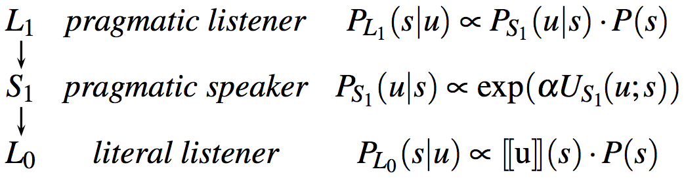
A vanilla RSA model
Set of world states:
S = {blue-square, blue-circle, green-square}
Set of utterances:
U = {“square", “circle", “green", “blue"}

Slide 16
Literal Listener L0
The naive, literal listener L0 interprets an utterance according to its meaning: she computes the probability of s (state) given u (utterance) according to the semantics of u and the prior probability of s
For example, the utterance “blue” is true of states “blue-square”, “blue-circle” and false of state “green-square”, [[u]]:S↦{0,1}
PL0(s∣u)∝[[u]](s)⋅P(s), where P(s) is an a priori belief regarding which state or object the speaker is likely to refer to in general
https://www.problang.org/chapters/01-introduction.html

Slide 17
Pragmatic Speaker S1
PS1(u∣s) ∝ exp(α(logL0(s∣u)−C(u))), α -- rationality, optimality of the choice of utterance, C(u) -- cost of utterance
https://www.problang.org/chapters/01-introduction.html

Slide 18
Pragmatic Listener L1
PL1(s∣u) ∝ PS1(u∣s)⋅P(s)
https://www.problang.org/chapters/01-introduction.html

Slide 19
Parallels with Grice
Grice | RSA
Quality
Quantity
Manner
Relevance

Slide 20
Parallels with Grice
recursive nature of RSA mimics the calculable nature of the conversational implicature (the listener thinks that the speaker thinks that the listener thinks…)
Grice | RSA
Quality | zero probabilities for false utterances
Quantity | the speaker favours informative utterances
Manner | the function of the cost of the utterance C(u)
Relevance | conditional probabilities: the choice of the utterance depends on the choice of the state, the choice of the state depends on the choice of the utterance

Slide 21
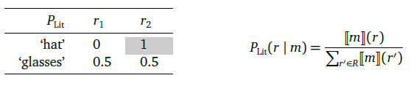
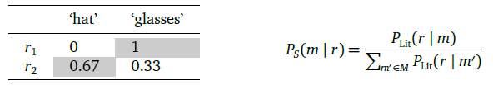
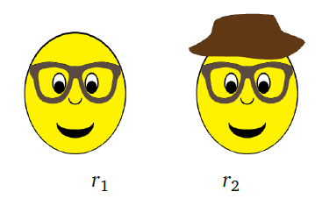
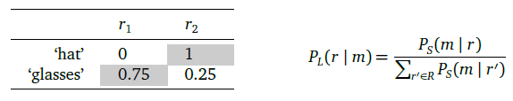
Simple scalar implicature
P(r1) = P(r2) = 0.5
C(m) = 0
α = 1

Slide 22
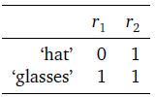
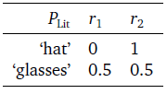

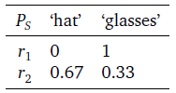
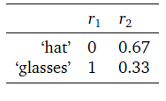
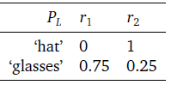
Simple scalar implicature
Start with the Lexicon: 2) Normalize by rows: 3) Transpose:
4) Normalize by rows: 5) Transpose: 6) Normalize by rows:

Slide 23
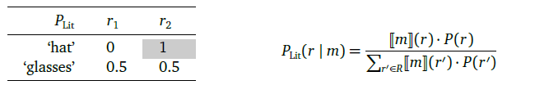
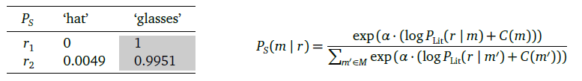
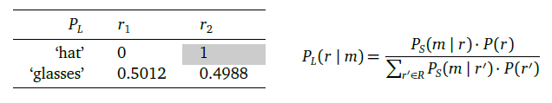
The role of the cost of the utterance
P(r1) = P(r2) = 0.5
C(‘hat’) = 6
C(‘glasses’) = 0
α = 1

Slide 24
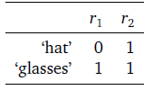

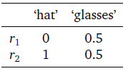
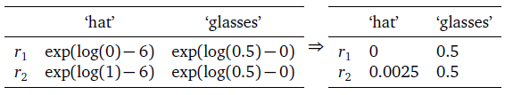
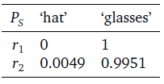
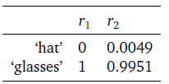
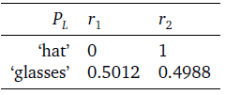
The role of the cost of the utterance
Lexicon 2) Normalizing by row: 3) Transposing:
4) Speaker (cost):
5) Normalizing by row: 6) Transposing: 7) Normalizing by row:

Slide 25

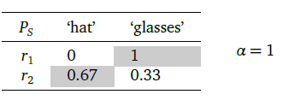
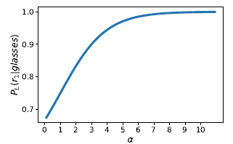
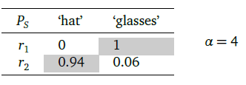
The role of alpha (rationality, optimality)

Slide 26
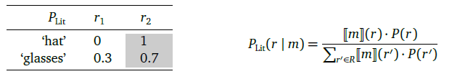
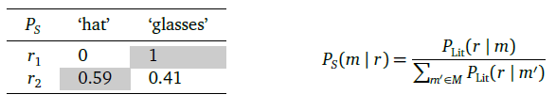
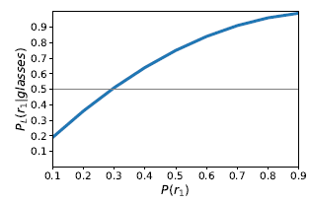
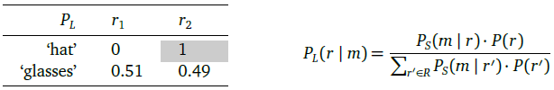
The role of the prior probability P(r)

Slide 27



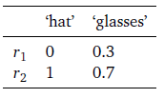


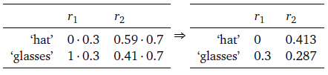

The role of the prior probability P(r)
Lexicon: 2) Introducing prior probabilities: 3) Literal listener:
4) Transposing: 5) Normalizing by row: 6) Transposing:
7) Introducing prior probabilities: 8) Normalizing by row:

Slide 28

Mini-experiment
r1 r2 r3
“hat”

Slide 29
Mini-experiment
literal listener, pragmatic listener, we: r3
r1 r2 r3
“hat”

Slide 30

Mini-experiment
r1 r2 r3
“glasses”

Slide 31
Mini-experiment
literal listener, pragmatic listener, we: r2
r1 r2 r3
“glasses”

Slide 32

Mini-experiment
r1 r2 r3
“hat”

Slide 33
Mini-experiment
literal listener: r1 -- 0.5, r2 -- 0.5
pragmatic listener: r1 -- 0.75, r2 -- 0.25
we:
r1 r2 r3
“hat”

Slide 34

Mini-experiment
r1 r2 r3
“mustache”

Slide 35
Mini-experiment
literal listener: r1 -- 0.5, r3 -- 0.5
pragmatic listener: r1 -- 0.33(3), r3 -- 0.66(6)
we:
r1 r2 r3
“mustache”

Slide 36

Mini-experiment
r1 r2 r3
“mustache”

Slide 37
Mini-experiment
literal listener: r2 -- 0.5, r3 -- 0.5
pragmatic listener expects r2
we:
r1 r2 r3
“mustache”

Slide 38

Mini-experiment
r1 r2 r3
“glasses”

Slide 39
Mini-experiment
literal listener: r1 -- 0.5, r2 -- 0.5
pragmatic listener expects r1
we:
r1 r2 r3
“glasses”

Slide 40

Mini-experiment
r1 r2 r3
“glasses”

Slide 41
Mini-experiment
literal listener/pragmatic listener/we: r1 -- 0.5, r3 -- 0.5
r1 r2 r3
“glasses”

Slide 42

Mini-experiment
we:
r1 r2 r3
“mustache”

